Slide 1
Unit 4
Applying Linear Equations
Algebra 1

Slide 2
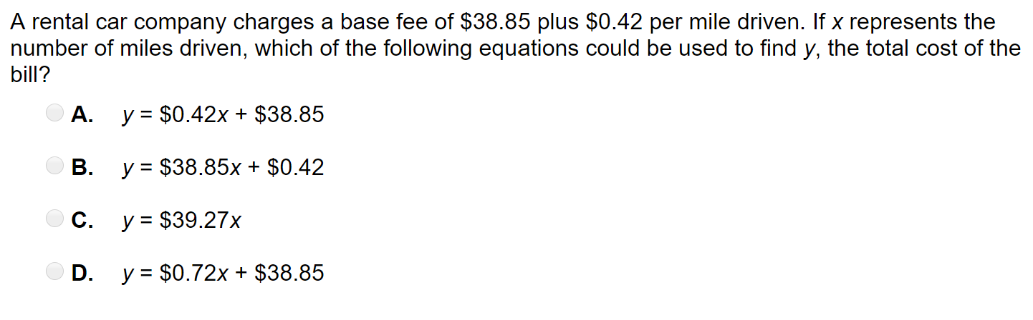
Word Problem

Slide 3
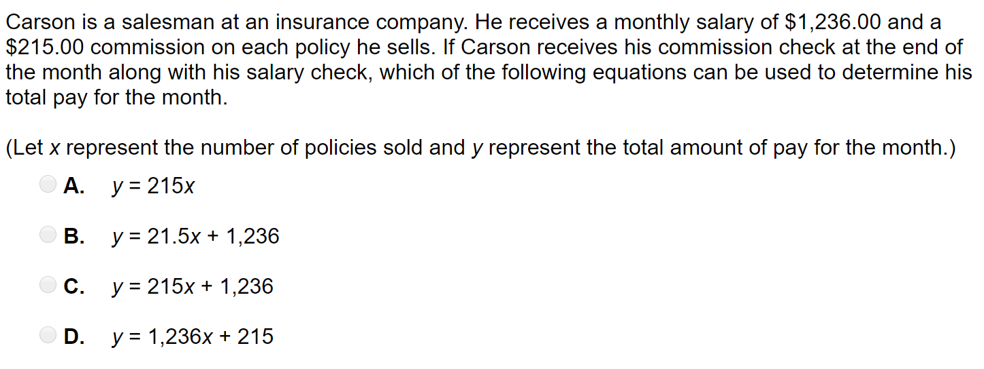
Word Problem

Slide 4
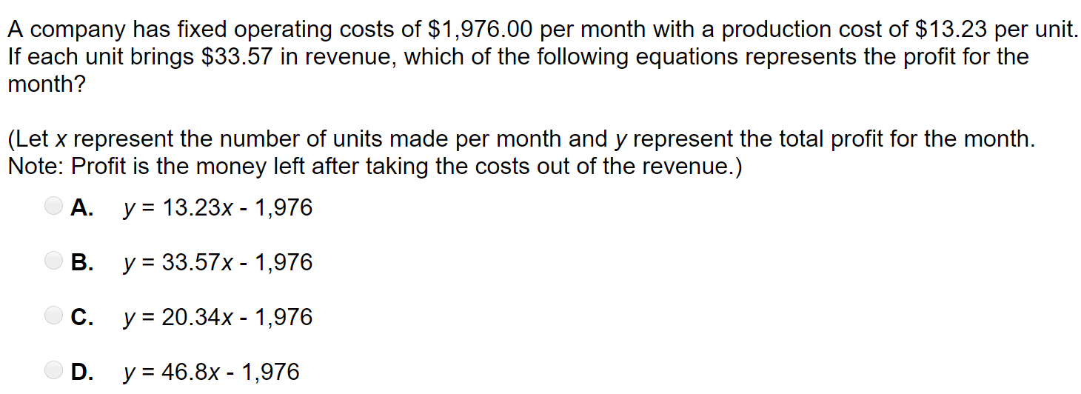
Word Problem

Slide 5
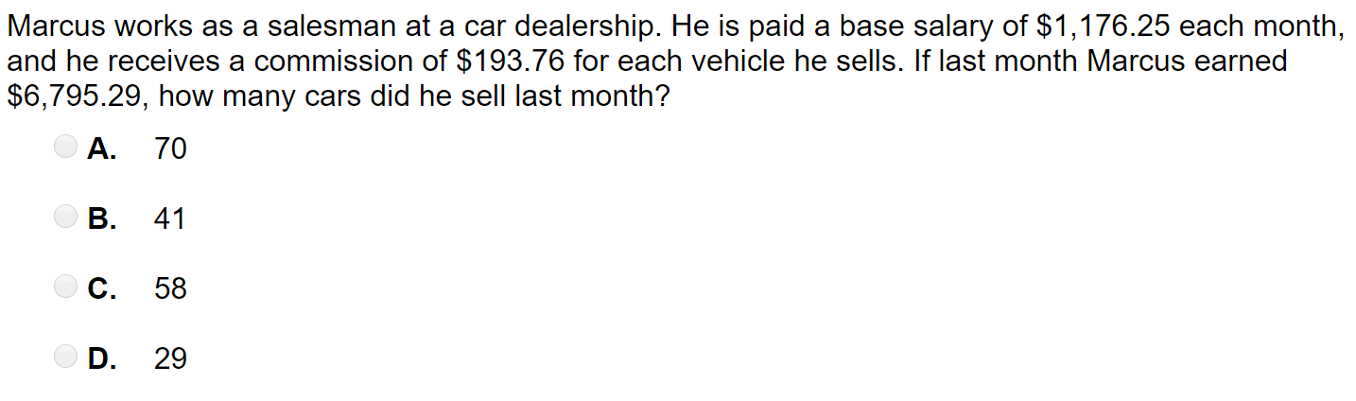
Word Problem

Slide 6
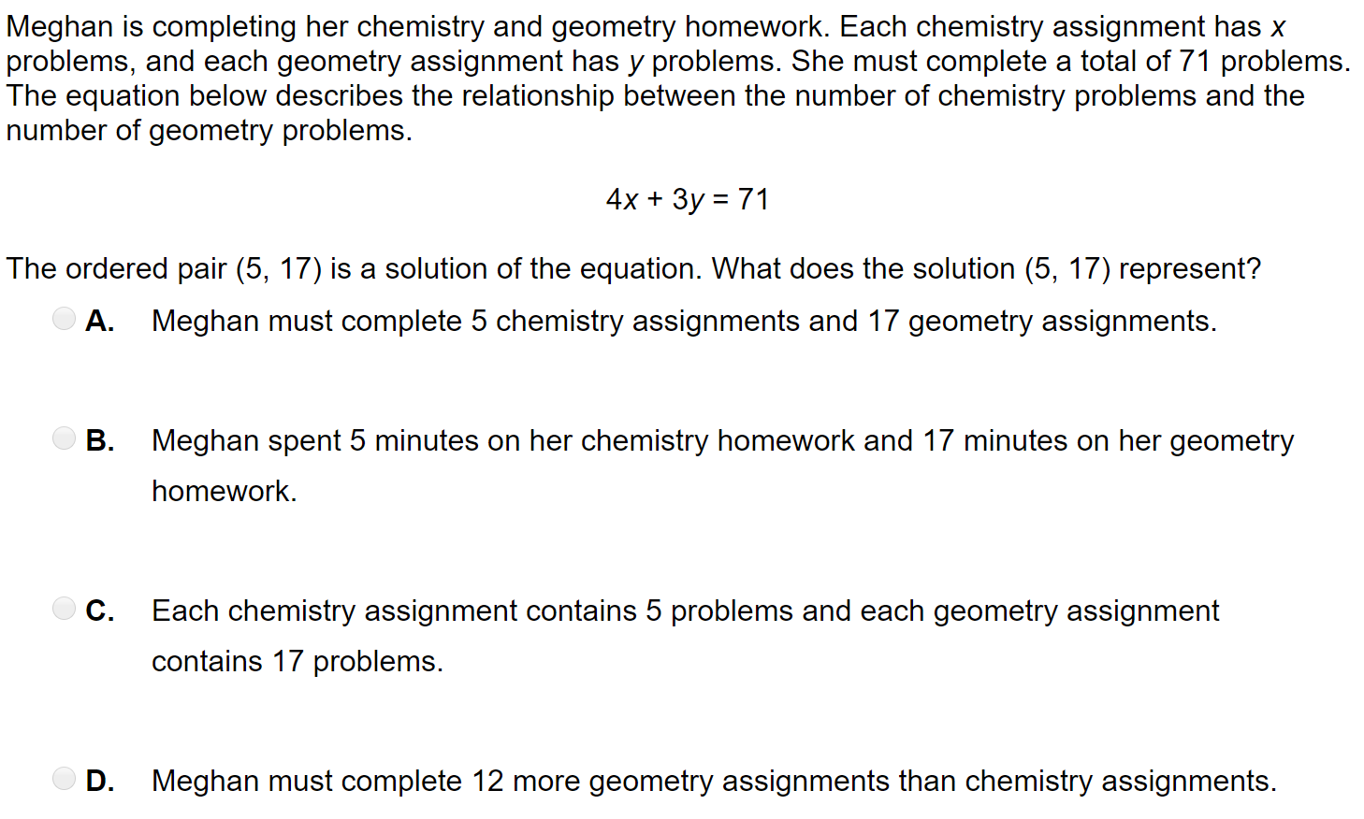
Word Problem

Slide 7
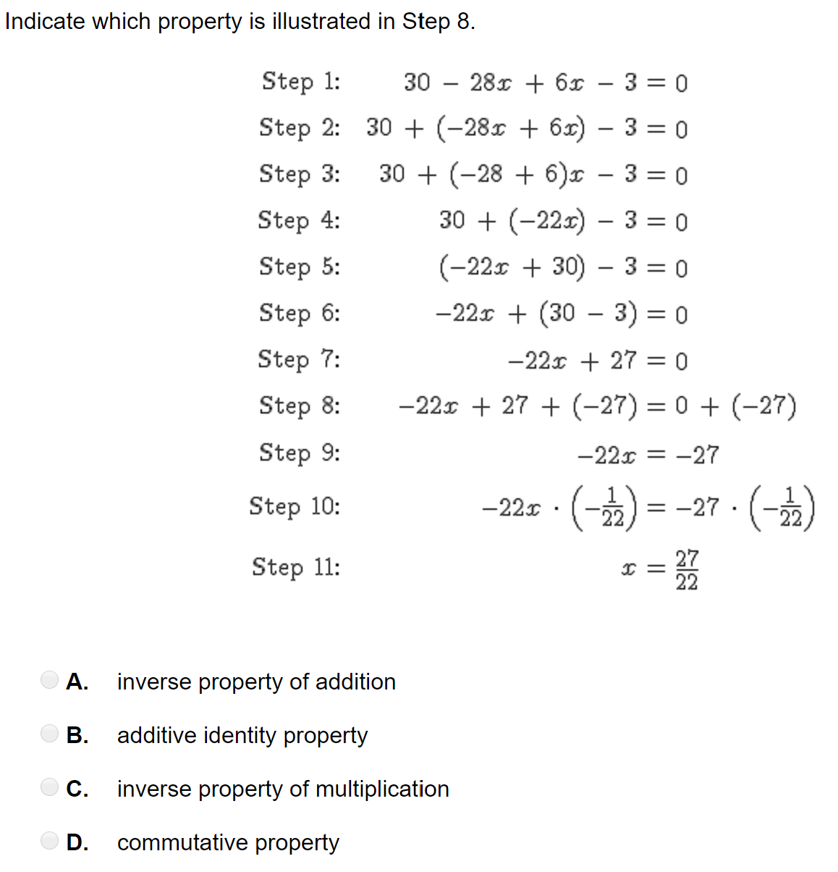
Word Problem

Slide 8
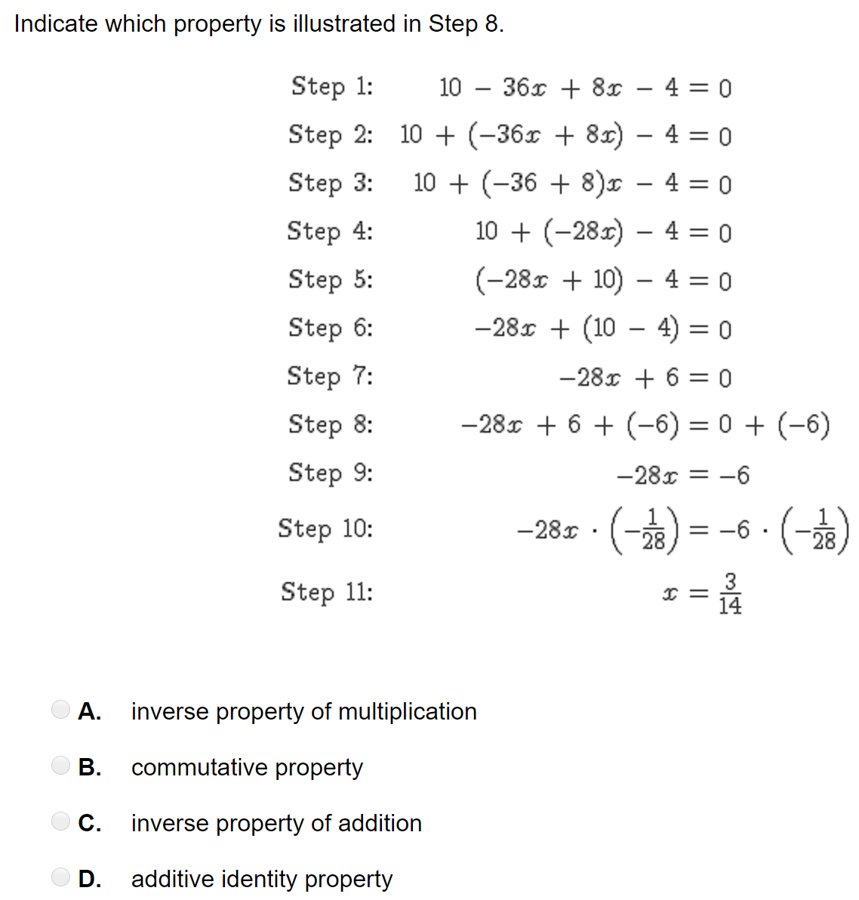
Word Problem

